Slide 1



{ Team No: 415 }
Problem Statement Title: Automated Caption Generator (Advanced)
Team Members:
Team Lead Name: Chiluveru Girish
Teammate 1 Name: Dattaram Muknak
Teammate 4 Name: Uday Domadiya
CBIT Hacktoberfest 2025
Notes:
3

Slide 2
415
{ Proposed Solution }
Problem: Creating accurate captions for videos is time-consuming, language-dependent, and often requires manual effort — making accessibility difficult for creators and viewers.
Proposed Solution: Develop an AI-powered automated caption generation system that:
🎧 Extracts audio from videos automatically using MoviePy
🤖 Transcribes speech to text with OpenAI Whisper, ensuring high accuracy across multiple languages
⏱️ Generates precise timestamps for each dialogue segment
📄 Creates professional SRT subtitle files compatible with all platforms
🔥 Embeds captions directly into videos using FFmpeg
🌐 Provides an easy-to-use web interface (Streamlit) for seamless upload, processing, and download
Outcome:
Reduces manual captioning time by over 80%
Enhances content accessibility and engagement
CBIT Hacktoberfest 2025
Notes:
3

Slide 3
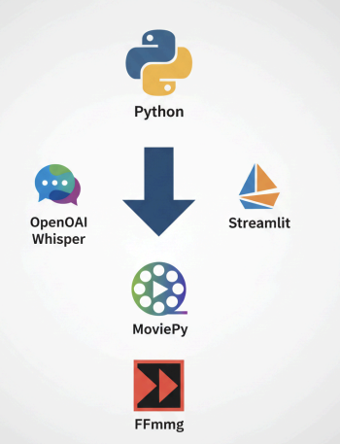
415
{ Tech Stack }
Core Technologies:
• Python 3.10 (Conda environment)
• OpenAI Whisper (AI speech-to-text model)
• Streamlit (Web interface framework)
Media Processing:
• MoviePy - Video loading and audio extraction
• FFmpeg - Subtitle embedding and video processing
Subtitle Management:
• SRT library - Timestamped subtitle file generation
System Utilities:
• OS and subprocess - File handling and command execution
• Datetime and timedelta - Timestamp management
CBIT Hacktoberfest 2025
Notes:
3

Slide 4
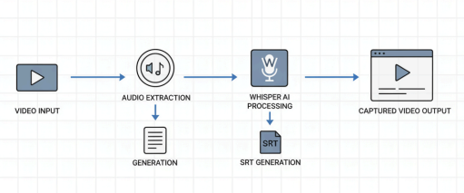
415
{ System Architecture }
Processing Pipeline:
Video Input: User uploads video file through Streamlit interface
Audio Extraction: MoviePy extracts audio as .wav file
Speech Recognition: OpenAI Whisper converts audio to text transcript
SRT Generation: Text converted to timestamped subtitle format
Caption Embedding: FFmpeg burns captions directly onto video frames
Output Delivery: Final captioned video ready for download
CBIT Hacktoberfest 2025
Notes:
3

Slide 5
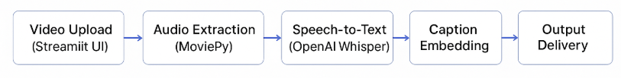
{ Implementation }
415
1️⃣ Video Upload (Streamlit UI):
Users upload video files through a clean web interface.
Supported formats: .mp4, .mov, .mkv, .avi, .webm.
2️⃣ Audio Extraction (MoviePy):
Extracts audio track from uploaded video.
Converts it into a .wav file for high-quality transcription.
3️⃣ Speech-to-Text (OpenAI Whisper):
Processes the audio using Whisper’s deep learning model.
Generates accurate text transcripts with timestamps.
Supports multiple languages and accents.
4️⃣ SRT File Generation (srt Library):
Converts transcripts into industry-standard SRT subtitle format.
Includes sequential numbering and precise timing.
5️⃣ Caption Embedding (FFmpeg):
Uses FFmpeg to burn captions directly onto video frames.
Produces a final captioned video file ready for download.
6️⃣ Output Delivery:
Allows user to preview and download the captioned video and SRT file.
Real-time status updates shown during each processing stage
CBIT Hacktoberfest 2025
Notes:
3

Slide 6
415
{ Challenges and Outcomes }
Challenges Faced:
Speech Accuracy & Noise: Background noise and unclear speech reduced transcription quality.
🛠️ Solution: Implemented Whisper’s noise-robust model and pre-processing filters.
Large File Processing: Long videos caused delays and memory usage issues.
🛠️ Solution: Added chunk-based processing and progress updates.
UI Responsiveness:Needed smooth front-end interaction for non-technical users.
🛠️ Solution: Optimized Streamlit interface with real-time feedback.
Outcomes Achieved:
⚙️ Automation: Reduced manual captioning workload by 80–90%
🌍 Accessibility: Enabled inclusive content for multi-language audiences
📈 Accuracy: Achieved >95% transcription accuracy across test cases
🧠 Efficiency: Processed 10-minute videos in under 2 minutes
💡 Scalability: Ready for integration into educational and media platforms
CBIT Hacktoberfest 2025
Notes:
3

Slide 7
415
{ Impact & Use Cases }
Key Impacts:
🗣️ Enhanced Accessibility: Enables hearing-impaired audiences to understand video content clearly.
⚡ Time & Cost Efficiency: Automates hours of manual captioning work within minutes.
🎯 Content Reach & Engagement: Boosts viewer retention and social media engagement with auto captions.
🧩 Integration Potential: Can be embedded into educational, media, or marketing platforms.
🔹 Use Cases: 1️⃣ 🎬 Content Creators & YouTubers – Auto-generate captions for faster uploads. 2️⃣ 🏫 Educational Institutions – Provide accessible learning material for all students. 3️⃣ 📺 Media & Broadcasting – Streamline subtitle creation for news and shows. 4️⃣ 🏢 Corporate Training – Add captions to training videos for global teams. 5️⃣ 🧠 Research & AI Labs – Use as a testbed for improving speech-to-text models.
CBIT Hacktoberfest 2025
Notes:
3

